Slide 1
Fluid-Objects Interaction
Physically Based Simulation - 2014
Ivo Nussbaumer and Michael Rabinovich

Slide 2
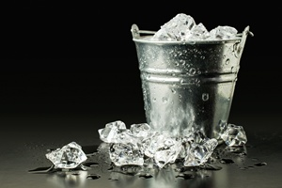
Some Inspiration

Slide 3
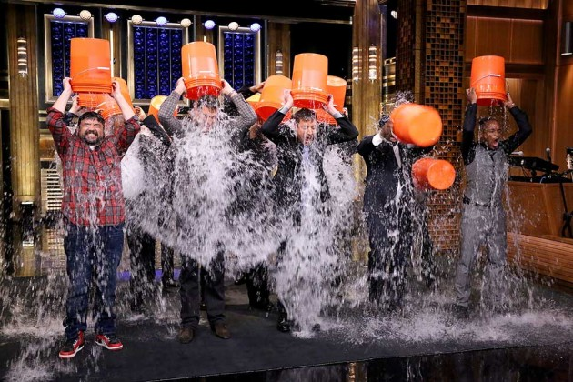
Ice Bucket Challenge

Slide 4
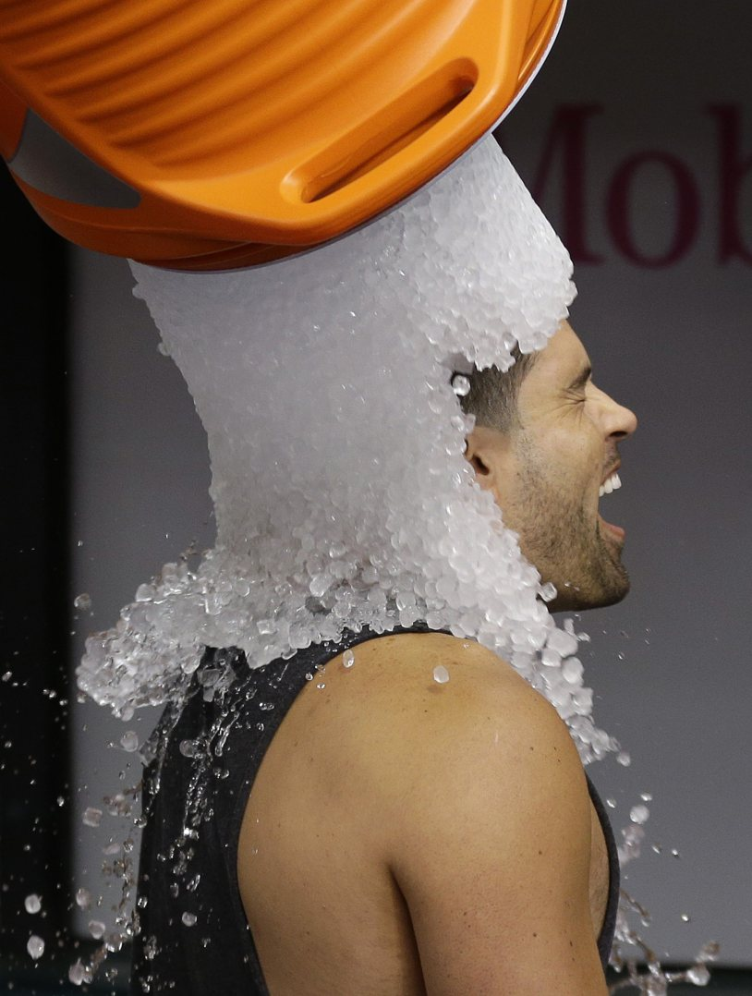
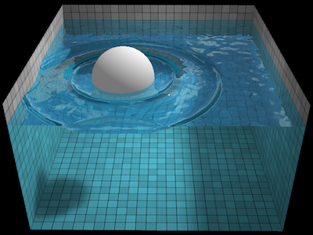
Fluid Interaction with Static Objects
Fluid poured over a mesh
Water/Sand
Floating Objects (Spheres/Ice Cubes)

Slide 5
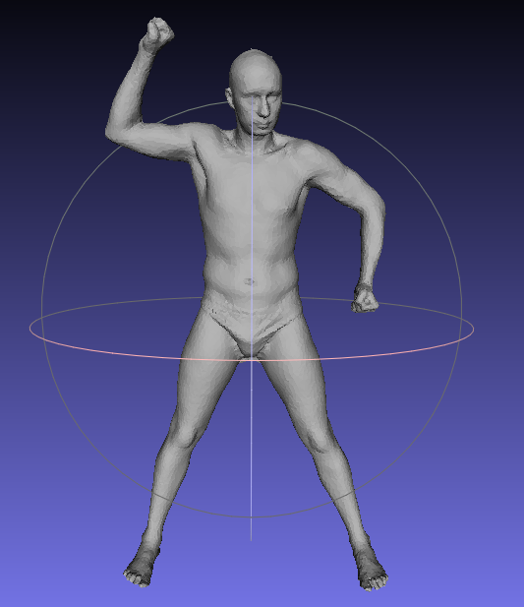
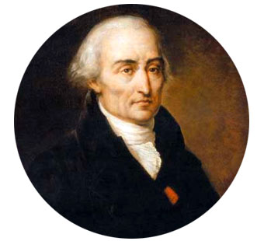
Ingredients
Rigid Body Collision Handling
SPH (Lagrangian method)

Slide 6
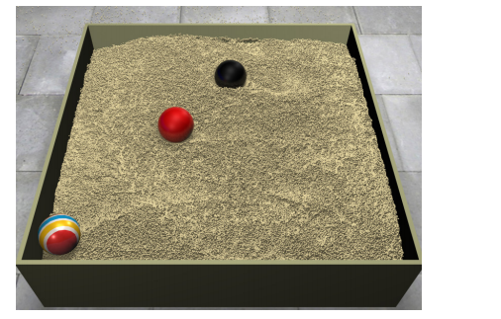
A bit more details
Standard SPH [Muller03]
Rigid Mesh Collision Handling (over a grid)
Scape Mesh [Anguelov et al. 2005]
Over 12,500 vertices
Sand [Ihmsen et al.2012]

Slide 7
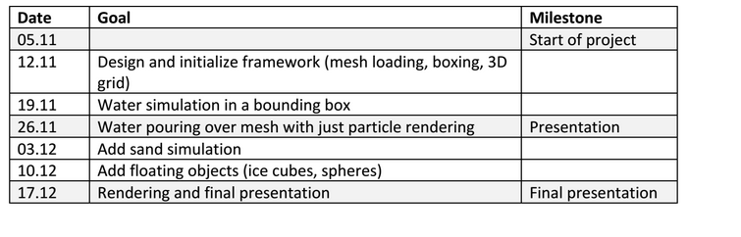
Timeline
On Time!

Slide 8
DEMO

